Slide 1
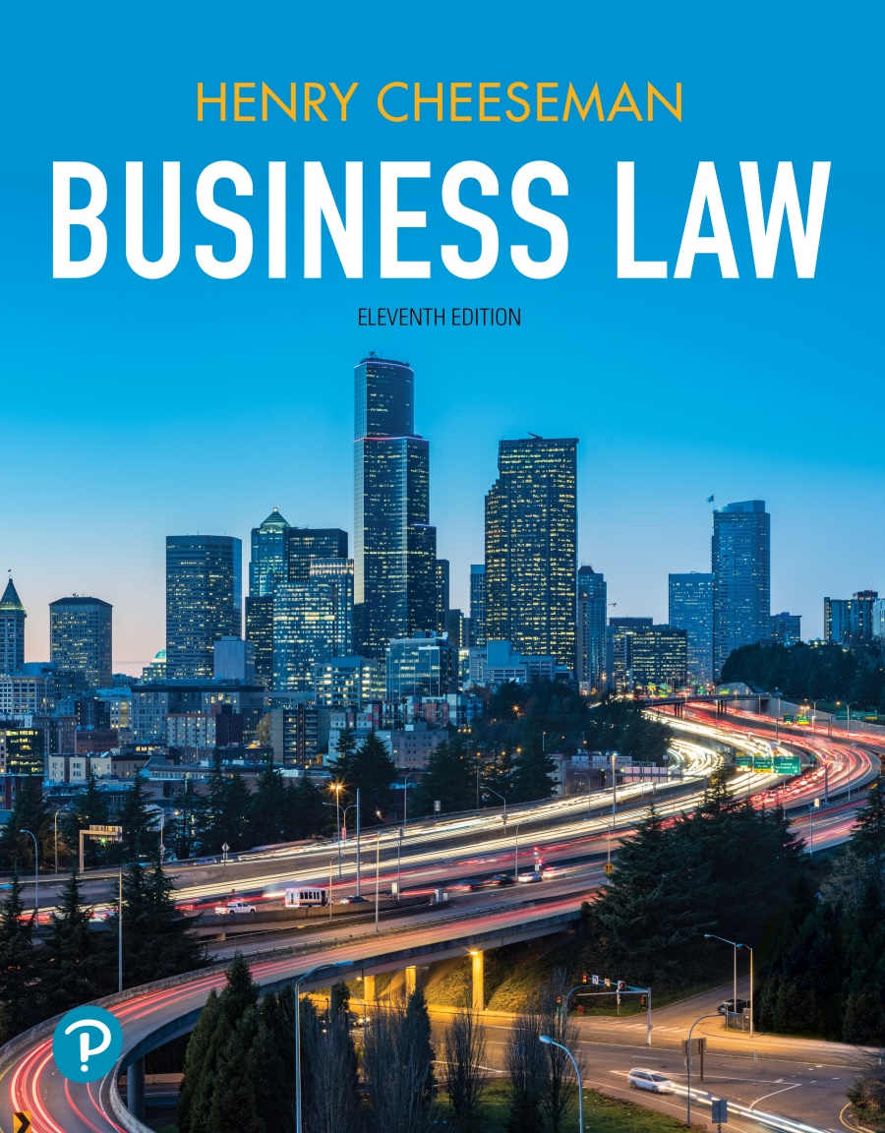
Business Law
Eleventh Edition
Chapter 1
Legal Heritage and the Information Age
Copyright © 2022, 2019, 2016 Pearson Education, Inc.

Slide 2
Learning Objectives (1 of 2)
1.1 Define law.
1.2 Describe the flexibility of the law.
1.3 List and describe the schools of judicial thought.
1.4 Learn the history and development of American law.
1.5 List and describe the sources of law in the United States.

Slide 3
Learning Objectives (2 of 2)
1.6 Describe the doctrine of stare decisis.
1.7 Describe how existing laws are being applied to the digital environment and how new laws are being enacted that specifically address issues of the information age.
1.8 Learn what critical legal thinking is and how to apply it to analyzing legal cases.
1.9 Learn how the material, cases, and lessons of this book will apply to your future career.

Slide 4
Definition of Law
Body of rules of action or conduct prescribed by controlling authority and having binding legal force
To be obeyed and followed by citizens, subject to sanctions or legal consequences
Notes:
Detail that laws are 1) rules 2) created by those in power that 3) can be enforced.

Slide 5
Functions of the Law
Keeping the peace
Shaping moral standards
Promoting social justice
Maintaining the status quo
Facilitating orderly change
Facilitating planning
Providing a basis for compromise
Maximizing individual freedom

Slide 6
Qualities of U.S. Law
Fairness
The U.S. legal system strives to be fair
Flexibility
U.S. law evolves and changes along with the norms of society, technology, and the growth and expansion of commerce in the U.S. and the world
The U.S. Supreme Court case Brown v. Board of Education is an example of flexibility of the law
Notes:
The U.S. legal system strives to be fare and flexible. Discuss with students that the qualities of a different legal system might diverge from these qualities. Describe how this class focuses on U.S. law, which likely differs from laws in other countries, especially those notions that do not have representative democracies.
When discussing the concept of fairness, tell students that the U.S. legal system tries to apply the law fairly and consistently. However, if you’d like, ask them to identify ways the U.S. legal system may not be fairly applied—perhaps for the poor, disenfranchised felons, people of certain races, etc.
When discussing flexibility, discuss how the Supreme Court in Brown v. Board of Education overturned its precedent set by Plessy v. Ferguson. In doing so the Court decided that the ”separate but equal” doctrine, particularly in education, was now unconstitutional under the Equal Protection Clause of the Fourteenth Amendment. One of the reasons the court changed its precedent was because the court was persuaded that “separate but equal” did indeed hurt minority children’s wellbeing by instilling in them a sense of inferiority—as evidenced in scientific findings.

Slide 7
Schools of Jurisprudential Thought (1 of 4)
Jurisprudence: The philosophy or science of law
Natural Law School
Law is based on what is “correct”
Law should be based on morality and ethics
Historical School
Law is an aggregate of social traditions and customs
Changes in the norms of society will gradually be reflected in the law

Slide 8
Schools of Jurisprudential Thought (2 of 4)
Analytical School
Law is shaped by logic
Results are reached by applying principles of logic to specific facts of a case
Emphasis is on the logic of result rather than on how the result is reached

Slide 9
Schools of Jurisprudential Thought (3 of 4)
Sociological School
Law is a means of achieving and advancing certain sociological goals
Purpose of law is to shape social behavior
Command School
Law is a set of rules developed, communicated, and enforced by the ruling party
The law changes when the ruling class changes

Slide 10
Schools of Jurisprudential Thought (4 of 4)
Critical Legal Studies School
Legal rules are unnecessary
Used by the powerful to maintain status quo
Legal disputes should be solved by applying arbitrary rules based on notions of what is fair
Law and Economics School
Promoting market efficiency should be the central concern of legal decision making

Slide 11
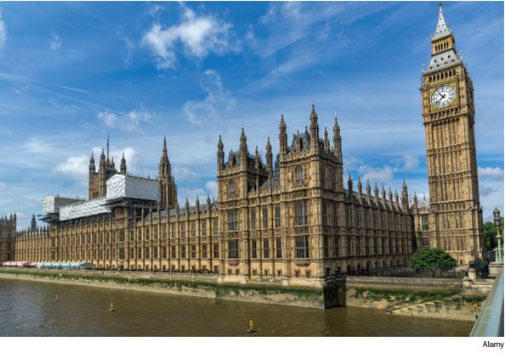
History of American Law
English system of law (“English Common Law”) was adopted as a system of jurisprudence in early American colonies
English Common Law is the foundation on which the American legal system is built
Notes:
Before the U.S. was a country, current parts of the U.S. were colonized by the British Empire. The colonies, as an arm of the British government, utilized English Common Law to govern. This type of law is the foundation on which the American legal system is built.

Slide 12
English Common Law (1 of 2)
Developed by judges who issued opinions when deciding cases
Principles announced in cases became precedent for future judges deciding similar cases

Slide 13
English Common Law (2 of 2)
Law Courts
Uniform system of law
Relief available was monetary award for damages
Courts of Chancery (equity courts)
Formed to surpass limited remedies of law courts
Equitable remedies shaped to fit each situation
Merchant Courts
Solved commercial disputes based on trade practices and usage
Notes:
INSTRUCTOR NOTE: This slide may be deleted, if you do not wish to go into the details of these separate courts.

Slide 14
Sources of Law in the United States (1 of 7)
Constitutions
The Constitution of the United States of America is the supreme law of the land
Any law that conflicts with it is unconstitutional and unenforceable
Establishes structure of federal government
Legislative branch
Executive branch
Judicial branch
States have their own constitutions, which are often modeled on the U.S. Constitution

Slide 15
Sources of Law in the United States (2 of 7)
Treaties
The President, with the advice and consent of two-thirds of the Senate, may enter into treaties with foreign governments
Treaties become part of the supreme law of land
Notes:
Ask students if they can name a treaty.

Slide 16
Sources of Law in the United States (3 of 7)
Federal Statutes
Written laws that establish certain courses of conduct that covered parties must adhere to
The U.S. Congress must find specific authority in the U.S. Constitution (such as the commerce, tax, and spend clauses) to enact federal statutes
Federal statutes are organized into code books
Code books constitute codified law

Slide 17
Sources of Law in the United States (4 of 7)
State Statutes
State legislatures enact state statutes
Ordinances
Law enacted by local government bodies
Ordinances are codified
Notes:
Ask the students to think of a state statute that applies to them (drinking age laws, no texting while driving laws, etc.). Do the same for local ordinances.
Help them see how many different types of law apply to them at any given time.

Slide 18
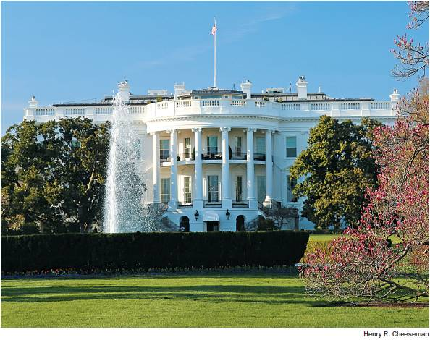
Sources of Law in the United States (5 of 7)
Executive orders
Issued by the president and state governors
Power derived from express delegation from the legislative branch and implied from U.S. Constitution and state constitutions

Slide 19
Sources of Law in the United States (6 of 7)
Regulations and Orders of Administrative Agencies
Established by legislative and executive branches of federal and state governments
Adopt rules and regulations to interpret statutes
Hear and decide disputes

Slide 20
Sources of Law in the United States (7 of 7)
Judicial decisions
Federal and state courts issue judicial decisions
Judicial decisions state the rationale used by the court in reaching that decision
Doctrine of Stare Decisis: Past court decisions become precedent for deciding future cases
Lower courts must follow precedent established by higher courts
Notes:
You also might want to describe to students that judge-made law or “common law” arises when a court is presented with a question in which no answer is currently offered by another type of law.

Slide 21
Priority of Law in the United States
The U.S. Constitution and treaties take precedence over all other laws
Federal statutes take precedence over federal regulations
Valid federal law takes precedence over conflicting state or local law
State constitutions rank as the highest state law
State statutes take precedence over state regulations
Valid state law takes precedence over local laws
Notes:
If you so choose, you can also add that common law is at the very bottom of this hierarchy. If there is ever a conflict between a judge made law and statute or other written law, the latter will win.

Slide 22
Digital Law
The electronic age arrived before new laws were written that were specific for this environment
Courts have applied existing laws to the new digital environment by requiring interpretations and applications
Congress has enacted new federal statutes to regulate the digital environment

Slide 23
Critical Legal Thinking
Consists of investigating, analyzing, evaluating, and interpreting information to solve simple or complex legal issues or cases
Requires intellectually disciplined thinking
Socratic method: Series of questions and answers
Give-and-take inquiry and debate between a professor and student
IRAC Method: Used to examine a law case
I (issue); R (rule); A (analysis); C (conclusion)

Slide 24
Case 1.1: Affirmative Action in University Admissions
Case
Fisher v. University of Texas at Austin
Supreme Court of the United States
Issue
Is the race-conscious admissions program at the University of Texas lawful under the Equal Protection Clause?
Notes:
Tell students that ultimately the Supreme Court decided that the admissions policy was “narrowly tailored” to serve the state’s compelling interest in ”the educational benefits that flow from a diverse student body.”

